Slide 1

Amazon Sales Dataset Analysis
Extracting Insights from Sales Trends, Customer Behavior, and Product Performance.
Eduardo Nunez.
This Photo by Unknown Author is licensed under CC BY-NC-ND

Slide 2
Introduction.
Welcome to the Amazon Sales Dataset Analysis project!
This analysis aims to uncover valuable insights into sales trends, customer behavior, and product performance.

Slide 3

Project Overview
Project Overview:
Understanding and analyzing sales data is crucial for businesses.
The dataset used in this project provides a rich source of information for such analysis.

Slide 4

Goals of the Project
Goals:
Derive insights into sales trends.
Understand customer behavior.
Evaluate the performance of different products.

Slide 5

Dataset Overview
Dataset Overview:
The dataset contains detailed information on transactions, including order dates, product details, and sales amounts.
Structured to facilitate in-depth analysis.

Slide 6
Installation
Clone the repository: git clone https://www.kaggle.com/datasets/anandshaw2001/amazon-sales-dataset
Navigate to the project directory: data set amazon-sales-analysis

Slide 7
Usage
Usage:
Open the project in your preferred SQL environment.
Run SQL queries to explore and analyze the dataset.
Power Point.
Tableau.

Slide 8
Example Queries And Questions
Customer Purchase History
Top Selling Products
Monthly Customer Spending
Best-Selling Categories by Revenue
SELECT SUM(sales_amount) AS total_sales FROM your_table_name;

Slide 9
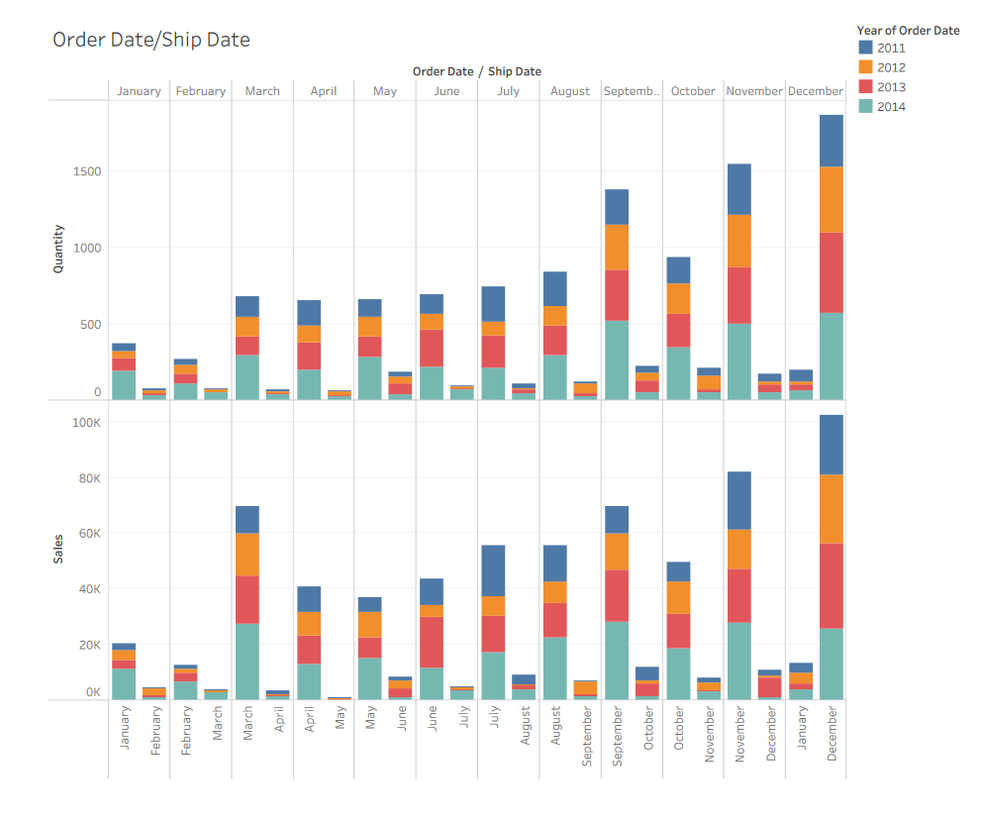
Analysis Highlights

Slide 10
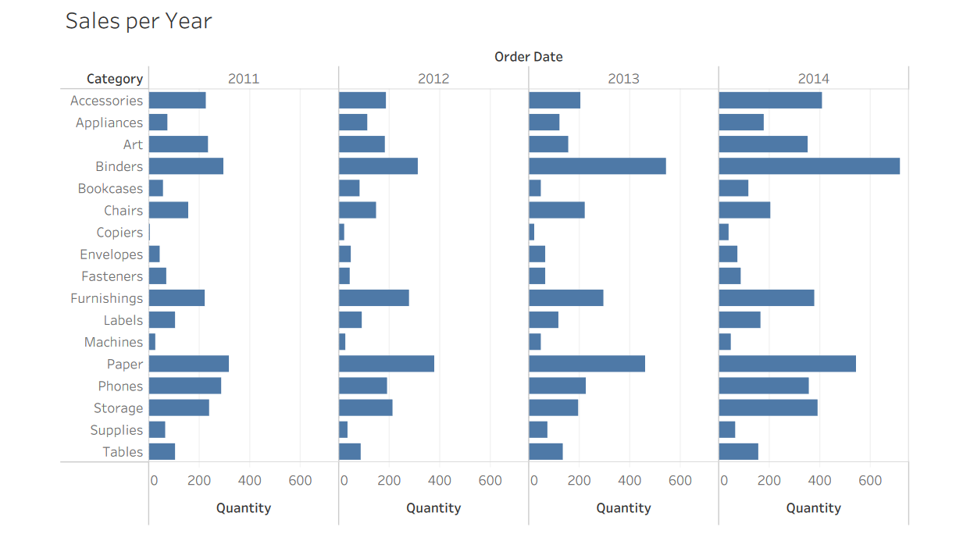

Slide 11
License
Kaggle

Slide 12

Conclusion
Key Findings and Takeaways
Through our analysis of the Amazon Sales Dataset, I've gained valuable insights into the dynamics of our sales, customer behaviors, and product performances.
Product category trends: There seems to be a recent surge in demand for household staples and essentials like health and personal care items, home office supplies, and groceries. On the other hand, demand for electronics like wireless devices and apparel seems to be declining.
Customer Behavior: find notable behaviors or trends among customers, such as repeat purchases or preferences.
Impact and Future Steps
Business Impact: The insights obtained have the potential to inform strategic decisions, enhance marketing efforts, and improve overall business performance.
Next Steps: As I conclude this analysis, consider the following steps:
Ongoing monitoring of sales trends.
Further exploration of customer preferences.
Continuous evaluation of product performance.
This Photo by Unknown Author is licensed under CC BY

